Slide 1
Traffic information acquisition system
Batch members:
● Gopi P
● Gautham krithick R

Slide 2
Problems Identified
Safety and comfort of road users is becoming a matter of grave concern.
It is essential to build a safer and much more reliable system for traffic control and management, since the number of on road accidents has shoot up greatly with the increase in vehicle traffic.
objective of this project is to introduce a system which detects all kind of vehicle at a street intersection and indicate the traffic using red light running.

Slide 3
Abstract
This project addresses the pressing need for improved safety and efficiency in traffic management systems by developing a Traffic Information Acquisition System. This system utilizes Arduino microcontrollers, sensors such as ultrasonic sensors, relay modules, and LED lights for traffic indication.
The objective is to detect various types of vehicles at street intersections and at curved paths where the visibility of vehicles is low and signal traffic using red light indicators.
This project report outlines the design, implementation, and analysis of the system's performance. By leveraging technology to enhance traffic control and management, this project aims to contribute to the safety and comfort of road users and pedestrians while reducing the risk of accidents caused by traffic congestion.

Slide 4
Existing System
The existing System has mirrors in the corners to identify the incoming vehicles in the curvy roads.
This mirror system is useful only in day time not in night.
Some other intersections follow timer based traffic light signal control this causes waste of time when there are few vehicles in the road.

Slide 5
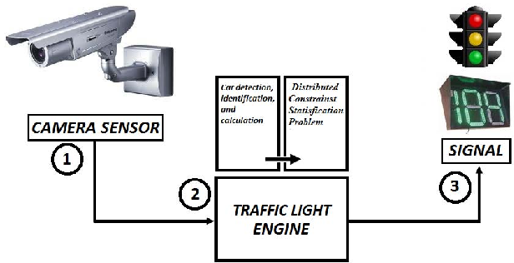
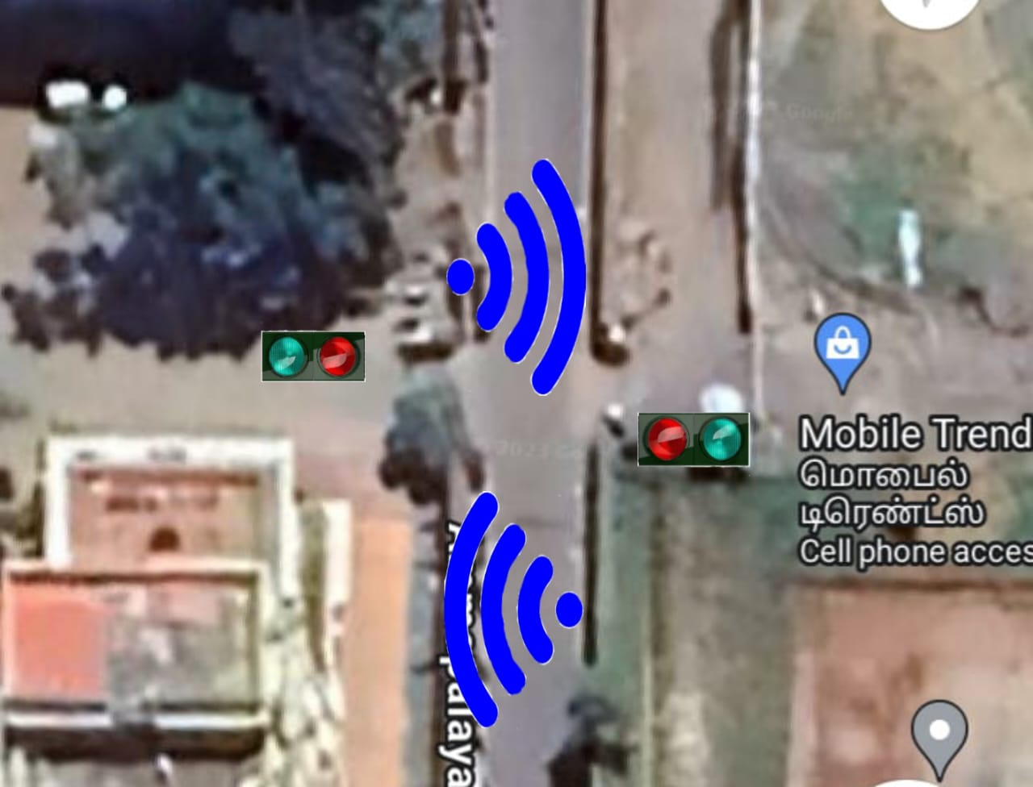
Work plan

Slide 6
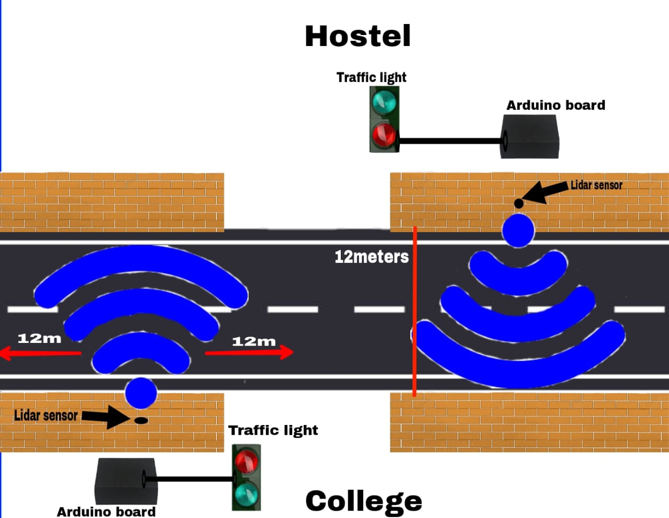
Methodology

Slide 7
Components Used
Arduino
Sensors (Ultrasonic Sensor)
Relay module
LED Lights for traffic indication

Slide 8
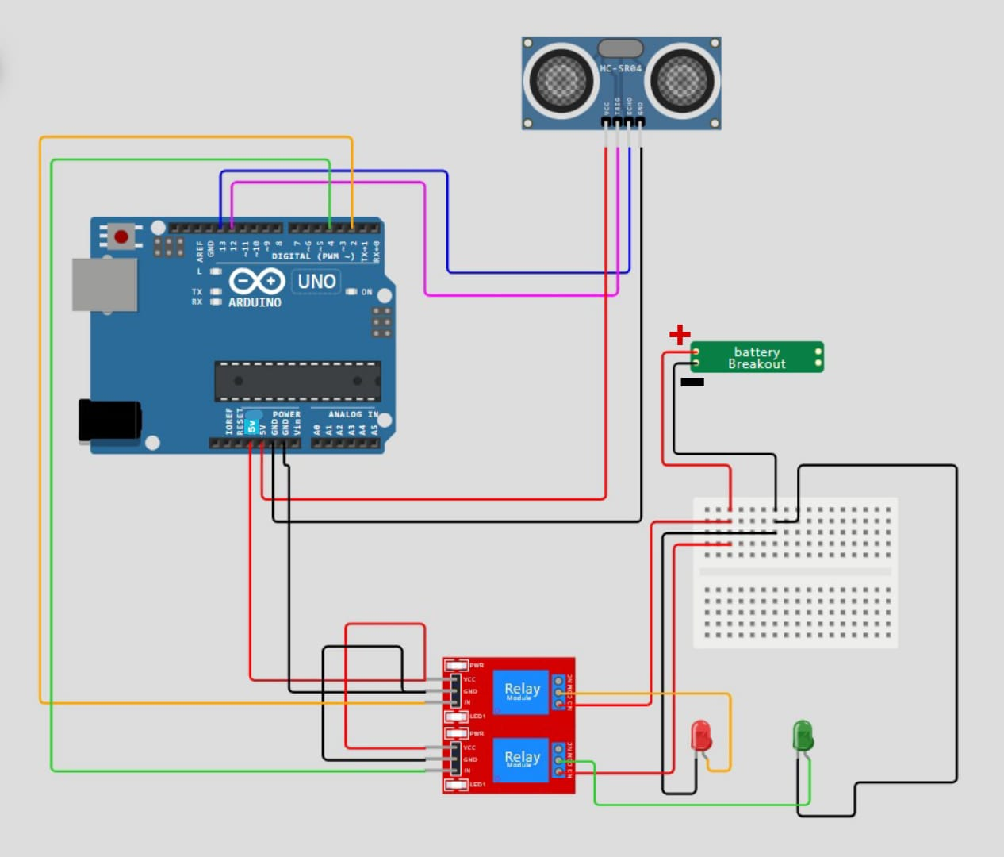
Circuit Diagram

Slide 9
Results and discussion
The output of this project is based on Two cases.
Case1
When the obstacle does not interrupt the signal of the sensor or greater than 200cm Green light will be switched ON.
Case 2 When the obstacle interrupt the signal of the sensor or lesser than 200cm Red light will be switched ON.

Slide 10
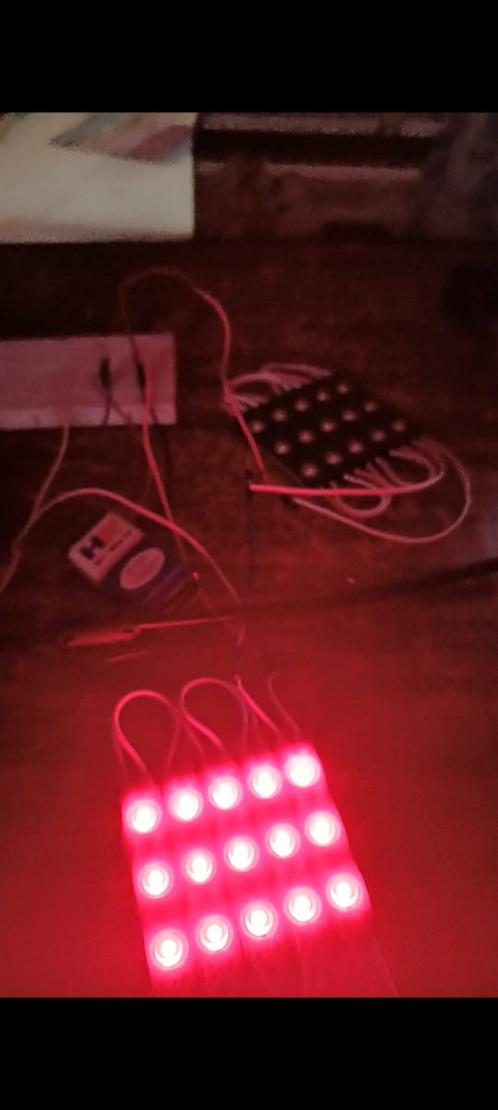
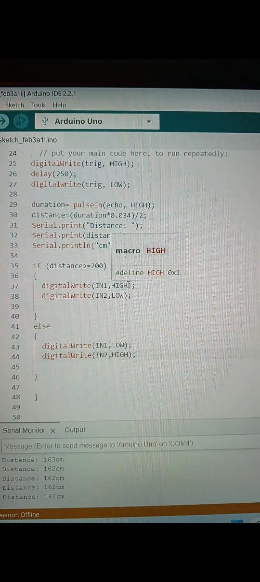

Slide 11
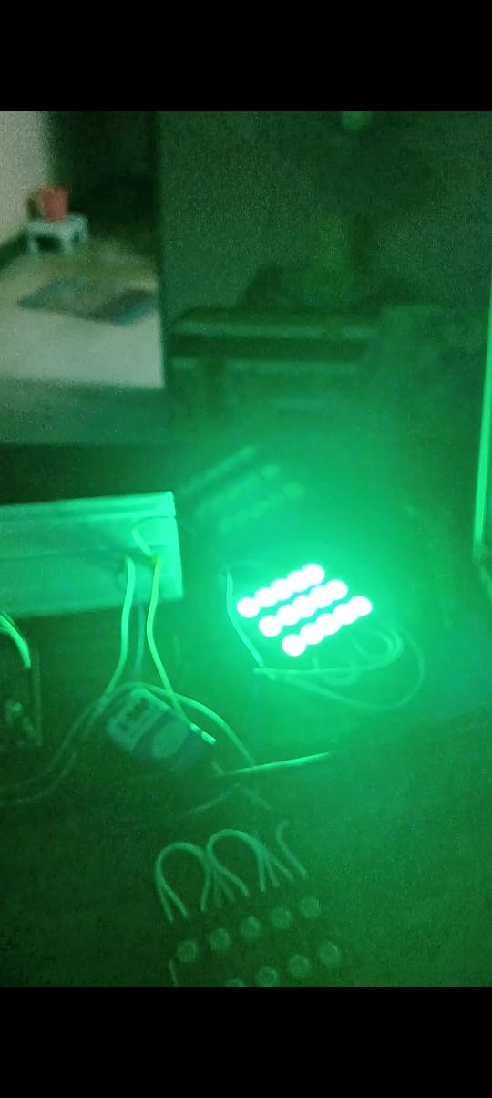
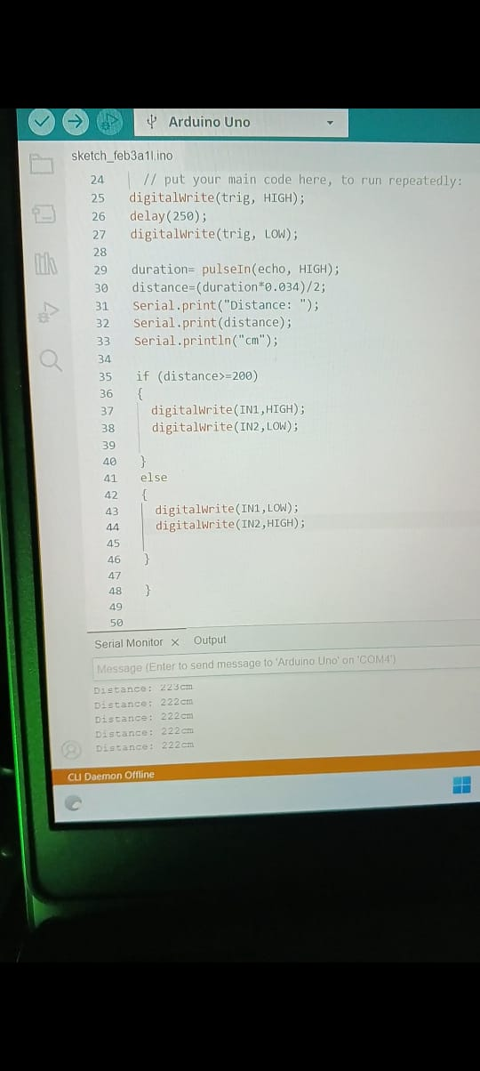

Slide 12
References
Ainun Machvira Addarani, Erfan Rohadi and Moechammad Sarosa, "Analysis of Driving Safety with Distance Detection Systems for Motorized Vehicles Using Ultrasonic Sensors", Published in: 2023 International Seminar on Intelligent Technology and Its Applications (ISITIA). DOI: 10.1109/ISITIA59021.2023.10220995.
A. M. Kamal, S. H. Hemel and M. U. Ahmad, "Comparison of Linear Displacement Measurements Between A Mems Accelerometer and Hc-Sr04 Low-Cost Ultrasonic Sensor", 2019 1st International Conference on Advances in Science Engineering and Robotics Technology (ICASERT), pp. 1-6, 2019. DOI: 10.1109/ICASERT.2019.8934569.
A.R. Patkar and P.P Tasgaonkar, "Object recognition using horizontal array of ultrasonic sensors", 2016 International Conference on Communication and Signal Processing (ICCSP), pp. 0983-0986, 2016, April. DOI: 10.1109/ICCSP.2016.7754294
C. Premebida, G. Monteiro, U. Nunes and P. Peixoto, "A LiDAR and vision-based approach for pedestrian and vehicle detection and tracking", 2007 IEEE Intelligent Transportation Systems Conference, 2007. DOI: 10.1109/ITSC.2007.4357637.
D. Wobschall, M. Zeng and B Srinivasaraghavan, "An ultrasonic/optical pulse sensor for precise distance measurements", 2005 Sensors for Industry Conference, pp. 31-34, 2005, February. DOI: 10.1109/SICON.2005.257865

Slide 13
THANK YOU

